Slide 1

Can Anyone Hear Me?
A Twitter Recommendation Engine
Creating more inclusive
social spaces
Alex Brooks
Notes:
Metis is a intensive 12-week program that’s taught me the core skills of a data scientist; from the assumptions of linear regression, to bagged and boosted classification models, word embeddings and text generation, to big data and cloud computing. It’s engrained in me a foundation I’ll have for the rest of my career.
And throughout this program I’ve been able to fully realize my own vision for 4 very unique projects end-to-end, from the ideation of the project itself, data collection to the models and techniques used. And I’ve been able to reinforce what I’ve learned with these project
Metis has said from the very beginning that the final project that we'll work on for our cohort is our passion project
I am very very fortunate to be able to synthesize all that I've learned and apply that knowledge to the subject of my passion, which I am happy to share with you today

Slide 2

📱 The Attention Economy 📱
Notes:
I’ve been really lucky to have worked in the social media space for the last two years and I am fascinated with studying consumer behavior. One of the questions that I always ask “why does someone spend their time with us?”.
The thing about deciding where to spend your time is there’s a level of trust and an emotional connection that goes along with that attention.
That attention is valuable, to brands, platforms, and most detrimentally to users themselves and it’s created a fragmented social (and overall digital) landscaped characterized by perpetual bombardment and saturation of content.
In a world that favors the sources that draw the most attention, we've lost what it means to be authentic in favor of flamboyant personas.

Slide 3

6,000
Tweets are tweeted on Twitter every second.
via: Brandwatch
Notes:
That corresponds to 500 million tweets per day, and around 200 billion tweets per year.

Slide 4

72%
of the public uses some type of social media.
via: Pew Research Center
Notes:
That's up from 69% the previous year.

Slide 5

73%
of Gen Z (18-22 year olds), report "sometimes" or "always" feeling alone.
via: Cigna Corp
Notes:
That's up from 69% the previous year.
The interesting thing about Gen Z is that they are the first generation to live completely in “the internet age”

Slide 6

AIMS & OBJECTIVES
Create a content-based recommender system using Tweets that a user has favorited only.
Topic modeling
Sentiment analysis
Dimensionality reduction / clustering
Personality classification
The goal is to create interpersonal connections without saturation of original content from a user.
Notes:
Used my Twitter ego network to create a content-based recommender system.
The main objective was to use favorites to test the hypothesis that genuine connections can be formed without saturation of original content.
Take the pressure off of being a mill of content and be "judged" on other aspects of your digital footprint that also tell the story of who you are online.

Slide 7

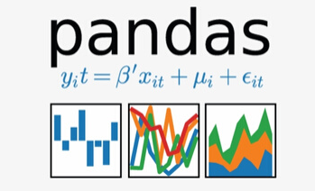
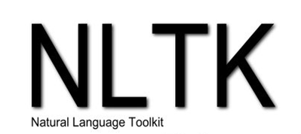




PROCESS & TOOLS
Data
Wrangling
Data Cleaning
& Text
Preprocessing
NLP
Modeling
Personality
Classification
Recommender
System
Dashboard Development
Notes:
1. Wrangling the profile attributes (number of followers, number of posts, number of favorites, etc.) and the favorites timeline from the API using Tweepy
2. Cleaned and preprocessed the text, including tokenization, removal of stopwords, removing punctuation, parts of speech tagging, and lemmatization.
3. After processing, created a count vectorizer to perform sentiment analysis using vader and topic modeling via non-negative matrix factorization, which identified 7 distinct topics within the corpus of favorited tweets.
4. Then dimensionality reduction using UMAP via single variable decomposition
5. Lastly, I utilized the IBM Watson API to create personality profiles for each user derived from the tweets that they engaged with.
6. All of these features were user to calculate the cosine distance between users to ultimately provide the basis for the recommender system.
7. Lastly, I produced a product for this recommender system via Tableau using a Twitter screen name as input and an output of recommended friends.

Slide 8
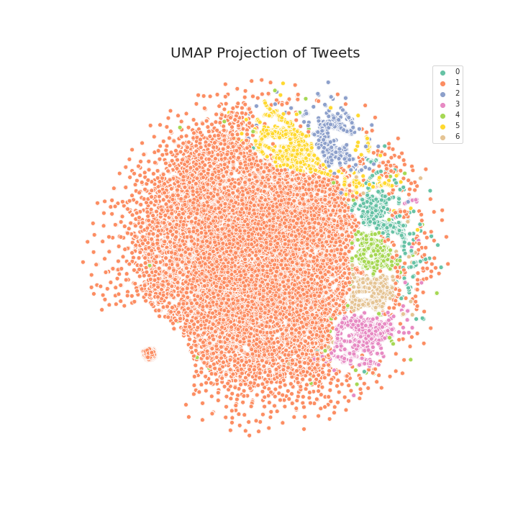
TOPIC MODELING
Topic 0 - Dating
Topic 1 - Current status
Topic 2 - Nostalgia
Topic 3 - Grievances
Topic 4 - Positivity
Topic 5 - Black Twitter
Topic 6 - Gratitude
Topics derived from NMF are indicative of the various moods as well as the Twitter "communities" present within my ego network.
Notes:
The topics derived from non-negative matrix factorization are indicative of the Twitter "communities" present within my immediate network.
I used the KMeans clustering alogrithm to assign each document to a cluster by calculating euclidian distance on the document-term matrix
What you see here are each of the tweets mapped with each cluster (or topic) plotted in a two-dimensional vector space with UMAP.
Topic 0 = friends airing out dating issues, problems with males/females
Topic 1 = general status updates, daily occurrences
Topic 2 = nostalgia, reminiscing
Topic 3 = airing out complaints
Topic 4 = optimistic outlooks on life, looking forward to going through the year
Topic 5 = topics relating to the African American community, culture, etc.
Topic 6 = thankful for friends, saying happy birthday, saying thank you
Distribution of topics derived to represent the % of tweets per user that fell within each cluster.

Slide 9
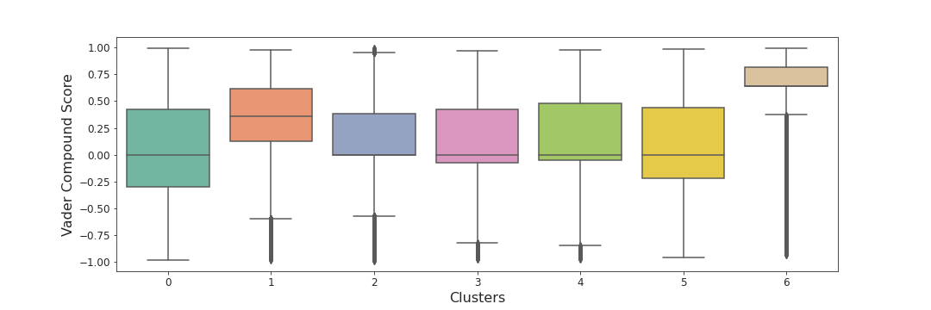
SENTIMENT DISTRIBUTION
Derivation of sentiment using Vader
Segmentation of sentiment by cluster (topic)
Attribution of sentiment per topic per user
Notes:
I used sentiment analysis on all documents to discern the range in emotion within each cluster
Vader analyzes the positive, negative, and neutral components of each document and aggregates these elements into a compound score (shown below)
So the final feature set included what % of tweets of each user fell within each topic and the average sentiment score attributed to each topic for each user.
What communities and topics each user is a part of and the general attitude toward those subjects.

Slide 10


Openness
Conscientiousness
Extraversion
Agreeableness
Emotional Range
CLASSIFICATION OF PERSONA
Notes:
- Concated all tweets to create corpora of texts per user.
- Created a script to pass the text through the IBM Watson API to develop a persona of each user; broken down into the "big 5" personality traits
Openness = being insightful, imaginative, havinng a wide variety of interests
Conscientiousness = being organized, methodic, reliability
Extraversion = energetic, talkative, assertive
Agreeableness = kind, affectionate, sympathetic. low --> more distant
Emotional range = moodiness, emotional stability

Slide 11
FIND YOUR TRIBE.
Click here

Slide 12


FUTURE WORK
Model relationships using a network graph. Improve recommender by using a community detection algorithm.
Expand network beyond first-degree connections.
Expand app design: conversation starters, example tweets from each user, etc.
Notes:
Relationships in a social network are complex. This involved analysis of language, identificationn of persona, even quantitative analysis of engagement. This could be better modeled using a graph.
Community detection algos I could use: walktrap, label propagation
Potential shortening of first bullet:
Network graph --> recommend via community detection.

Slide 13

In the social jungle of human existence, there is no feeling of being alive without a sense of identity.
— Erik Erikson
Notes:
A quote from psychologist Erik Erikson [read quote]
For all of us, especially for younger generations, we form that identity through our experiences and connections and rections online.
I challenge you to think about what are the things that you value in people and relationships offline and how this can be better reflected in what we value online.

Slide 14





THANK YOU
EMAIL ADDRESS
brooks.alexr@gmail.com
PHONE NUMBER
(757) 561 - 8904
Notes:
May want to change this slide so that the URLs are spelled out and the icons are next to them? People will be watching this, don’t rely on them to go to the PDF and click the link.
Like; email then gmail icon, LinkedIn URL then LinkedIn icon, etc.

